Slide 1
New Efficient Algorithms for the LCS and Constrained LCS
Problems
Costas S. Iliopoulos and M. Sohel Rahman
Information Processing Letters (2007), doi: 10.1016/j.ipl.2007.09.008
Speaker: Chun-Jen Chen
Date: Oct 31, 2007

Slide 2
Abstrct
In this paper, we study the classic and well-studied longest common subsequence (LCS) problem and a recent variant of it, namely the constrained LCS (CLCS) problem. In the CLCS problem, the computed LCS must also be a supersequence of a third given string. In this paper, we first present an efficient algorithm for the traditional LCS problem that runs in O(Rlog log n+n) time, where R is the total number of ordered pairs of positions at which the two strings match and n is the length of the two given strings. Then, using this algorithm, we devise an algorithm for the CLCS problem having time complexity O(pRlog log n + n) in the worst case, where p is the length of the third string.

Slide 3
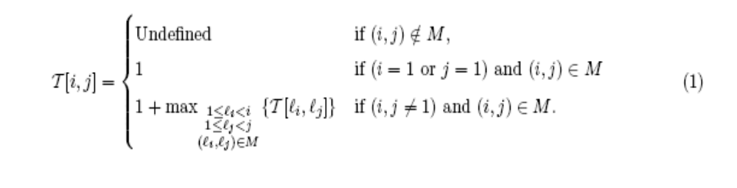
LCS problem
We follow the simple dynamic programming formulation of [16] and improve its running time of O(n2 + R) to O(Rlog log n + n). The dynamic programming formulation from [16] is as follows:

Slide 4
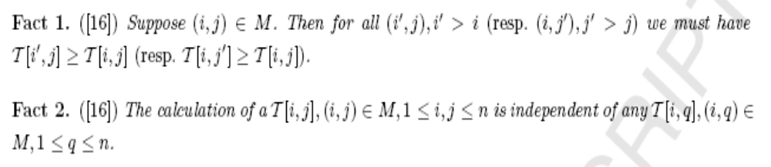
The Fact

Slide 5
BoundedHeap
Insert(H, Pos, V, Data): Insert into the BoundedHeap H the position Pos with value V and associated information Data.
IncreaseValue(H, Pos, V, Data): If H does not already contain the position Pos, perform Insert(H, Pos, V, Data). Otherwise, set this position’s value to
max{V, V’}, where V’ is its previous value. Also, update Data accordingly.
BoundedMax(H,Pos): Return the item (with additional data) that has maximum value among all items in H with position smaller than Pos. If H does not contain any items with position smaller than Pos, return 0.
Theorem 1. BoundedHeap data structure can support each of the above operations in O(log log n) amortized time, where keys are drawn from the set {1, . . . , n}. The data structure requires O(n) space.

Slide 6
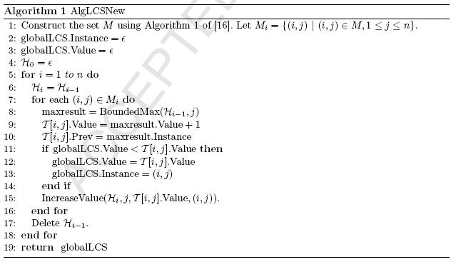
AlgLCSNew

Slide 7
AlgLCSNew
 | T | C | C | A | C | A
 | 0 | 0 | 0 | 0 | 0 | 0
A | 0 | 0 | 0 | 1 | 0 | 1
C | 0 | 1 | 1 | 1 | 2 | 1
C | 0 | 1 | 2 | 1 | 2 | 1
A | 0 | 1 | 2 | 3 | 2 | 3
A | 0 | 1 | 2 | 3 | 2 | 4
G | 0 | 1 | 2 | 3 | 2 | 4
{ 0, 0, 0, 1, 0, 1 }
{ 0, 1, 1, 1, 2, 1 }
{ 0, 1, 2, 1, 2, 1 }
{ 0, 1, 2, 3, 2, 3 }
M={(1,4) ,(1,6) ,(2,2),(2,3),(2,5) ,(3,2) ,(3,3) ,(3,5), (4,4) ,(4,6) ,(5,4) ,(5,6)}

Slide 8
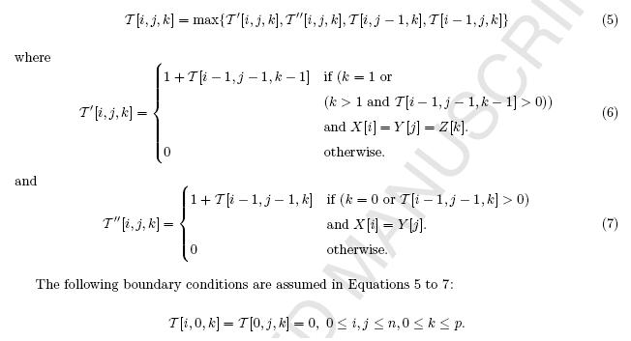
CLCS algorithm
It is straightforward to give a O(pn2) algorithm

Slide 9
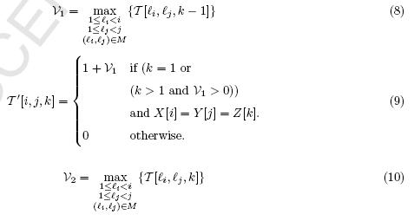
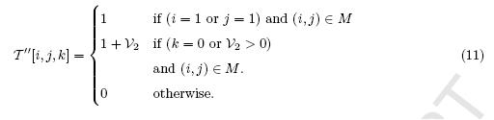
AlgCLCSNew

Slide 10
